Slide 1
FAST DataBases
Static Data Master, TFS Structure and Coding Standards
Srinivas.V
15th July 2014

Slide 2
DataBases
FASTPROD – FAST Production
FA_BPM – WorkFlow
FAST_IMAGING – Imaging
NUCLEUS – FileSearch

Slide 3
LookUp Tables
TypeCdDmt
All the master type codes will be stored in TypeCdDmt table.
Contains the various type definitions that constitutes a class.
For e.g. Transaction Type, Business Segment types, etc.
ClassType
This table stores the groups under which the type codes are defined. Class types are defined with an unique ID that needs to be booked under Static Data Master script in TFS.

Slide 4
Static Data Master
We are maintaining the static Data with Static Data Master script, to maintain consistency with different projects.

Slide 5
Available Static Scripts
Static Data Master Script
BPM Static Data Master Script
Nucleus_Static Data Master Script

Slide 6
Below are some tables which are in Static Data Master script.
ClassType
TypeCdDmt
Activity
DocTypeDmt
Event
Application
ServiceOperation

Slide 7
TFS
We have below TFS Structure for FAST
Every Branch contains DBA Folder.
Inside DBA we have Scripts Folder.
Inside Scripts We have Separate folder For Tables, SP’s and DataFix..etc..

Slide 8
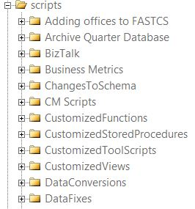

Slide 9
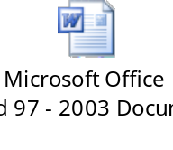
Coding Standards
We have Coding Standards InPlace.

Slide 10
Q & A
???

Slide 11
Thank You

